Slide 1


TASK 5
INTERNET PROGRAMMING ANG MOBILE PROGRAMMING
UI DESIGN AND IMPLEMENTATION

Slide 2
Table of Content
Introduction
Conclusion
UI Design Overview
Designs Principles
UI Design Process
UI Implementation

Slide 3
Introduction
To address these issues and usher in a new era of efficient attendance tracking, this report presents the UI design and implementation of a biometric student attendance mobile application.

Slide 4
UI Design Ovieview
User interface (UI) design is the process designers use to build interfaces in software or computerized devices, focusing on looks or style. Designers aim to create interfaces which users find easy to use and pleasurable

Slide 5


To designs UIs best, you should consider
Uses judge designs quickly and care about usability and likeability
UIs should also be enjoyable (or at least satisfying and frustration-free
UIs should communicate brand value and reinforce users’ trust

Slide 6
Designs Principles
Simplicity and Clarity
Responsiveness
Feedback and Response
Aesthetics

Slide 7
UI Design Process
Research and Requirement Gathering
User Personas
Stakeholder Interview
Competitive Analysis

Slide 8
UI Design Process
Low Fidelity Sketches
After conducting research, we created low –fidelity sketches to map out the user flow and the app’s layout. The sketches allowed us to visualize the app’s structure and ensure that the user flow was intuitive

Slide 9
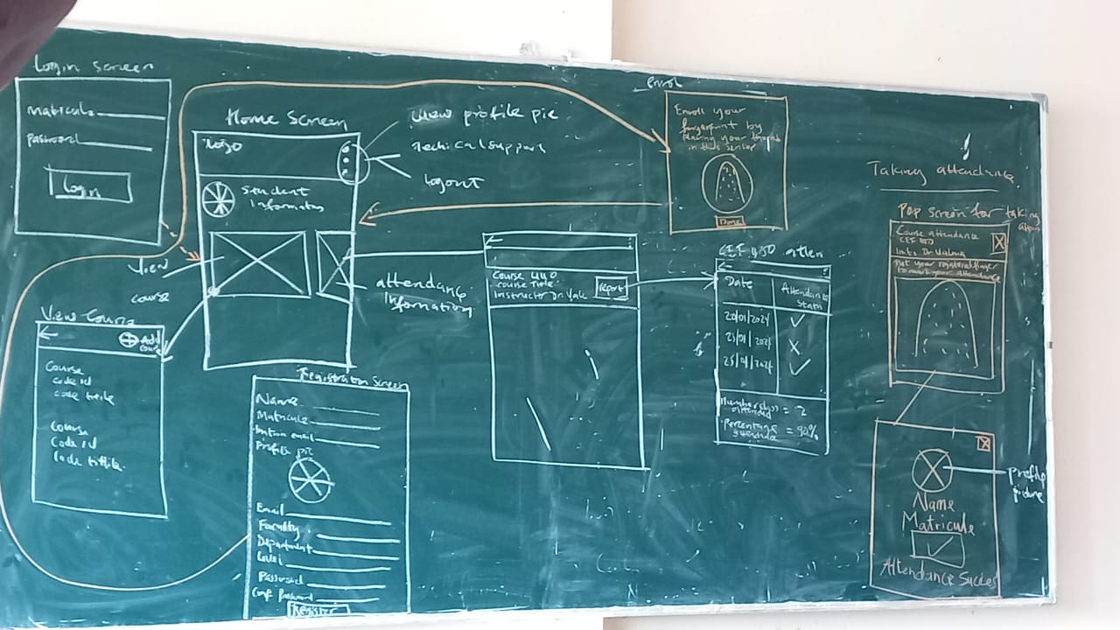
UI Design Process
Low Fidelity Sketches of student Interface

Slide 10
UI Design Process
Prototyping
With the wireframes finalized, we developed high-fidelity interactive prototypes using Figma, a collaborative design tool. The prototype allowed us to text the user flow and user interface design

Slide 11
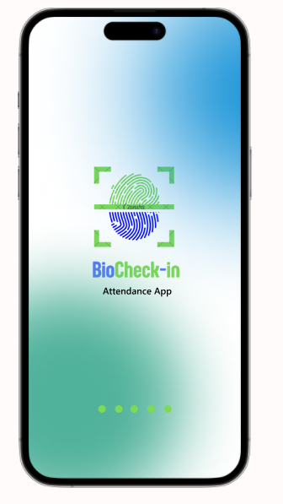
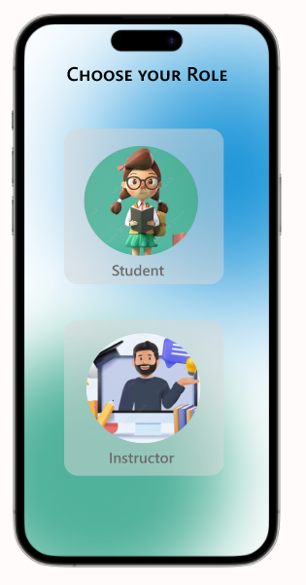
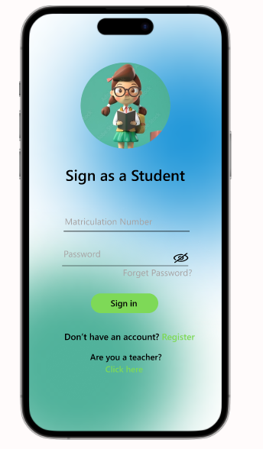
Key UI Component
Welcome Screen

Slide 12
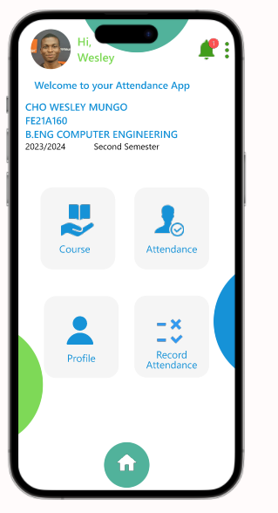
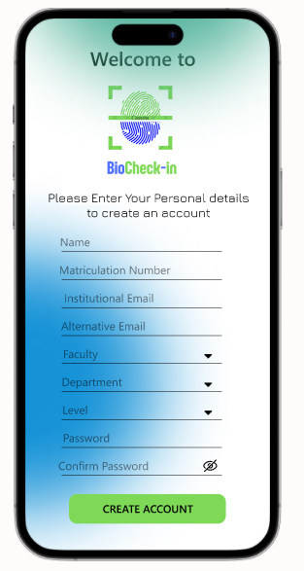
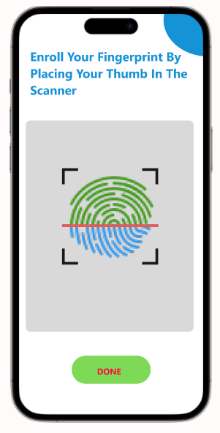
Student UI Interface Designs

Slide 13
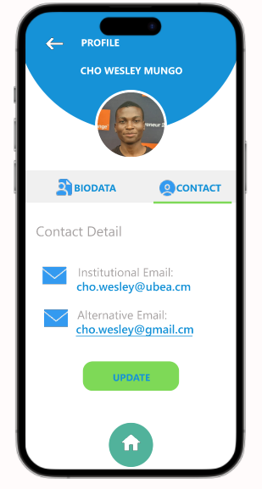
Home and Profile Screens

Slide 14
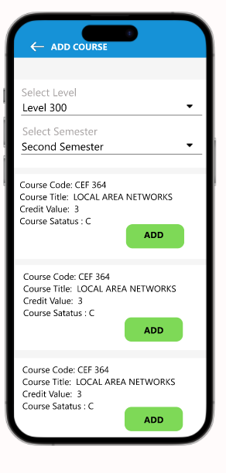
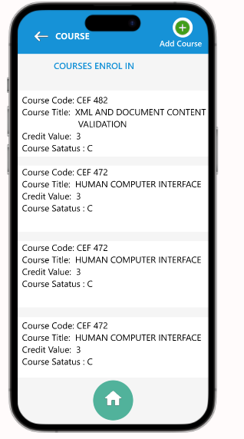
Home, Course and Add course Screen

Slide 15
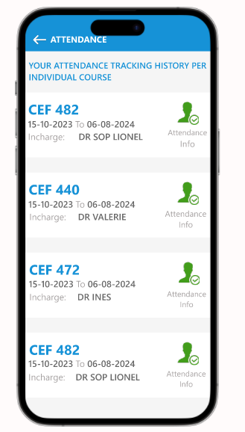
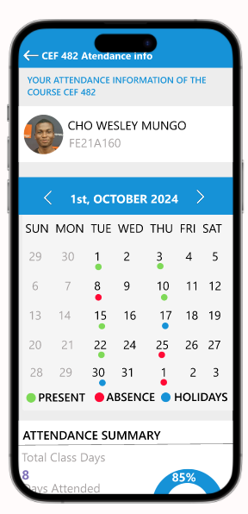
Home, Attendance and Attendance info Screen

Slide 16
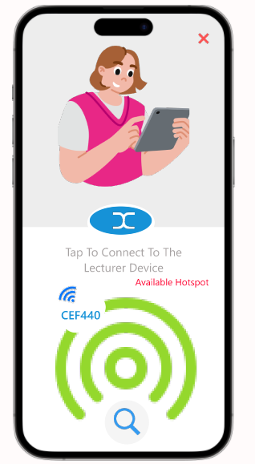
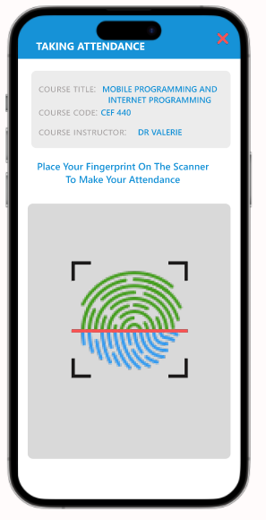
Home, Record and Taking Attendance Screens

Slide 17
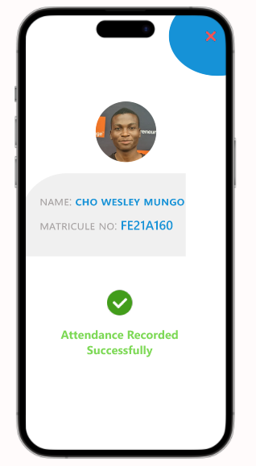

Slide 18
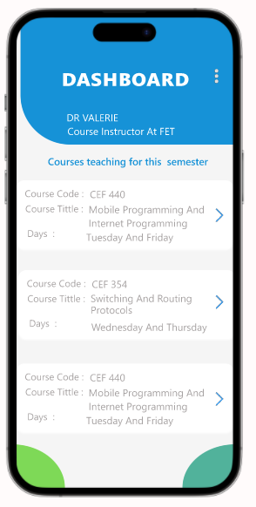
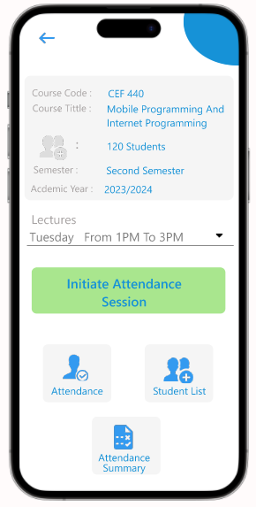
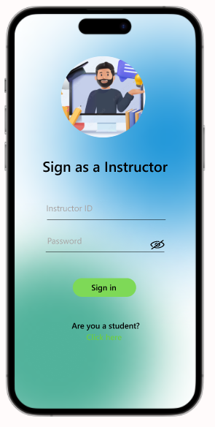
Key UI Component
Instructor Interface Designs

Slide 19
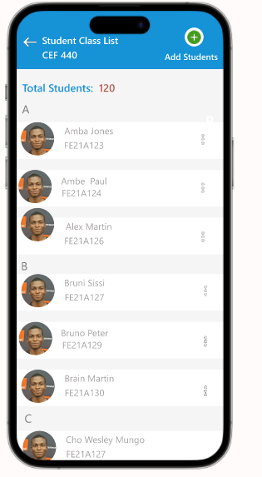
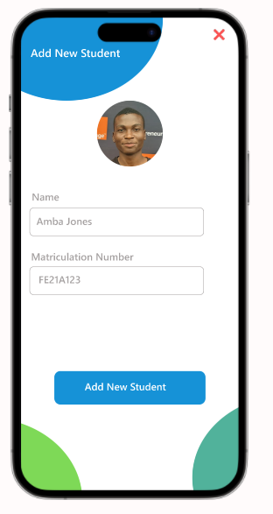

Slide 20
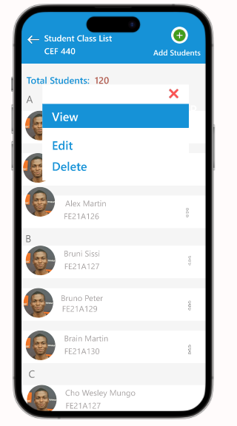
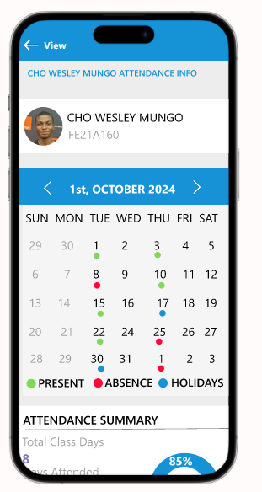

Slide 21
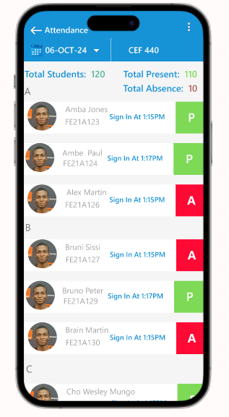

Slide 22
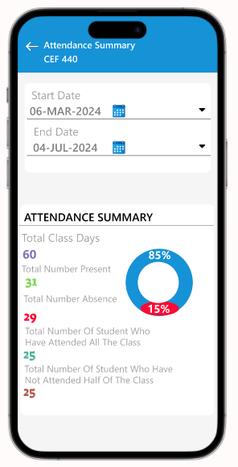

Slide 23
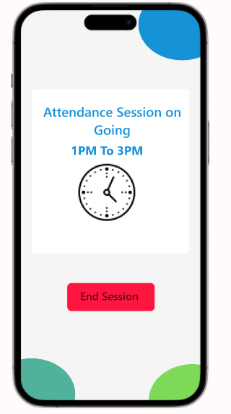
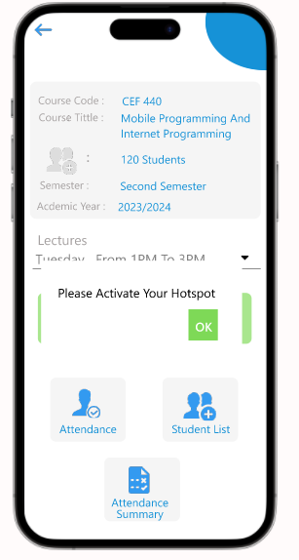

Slide 24
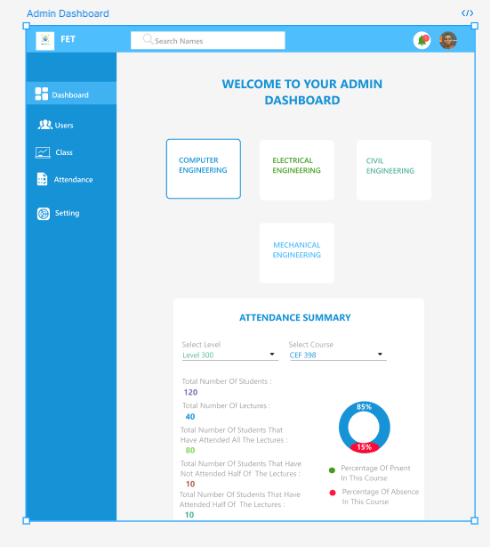
Key UI Component
Administrative Interface Designs

Slide 25
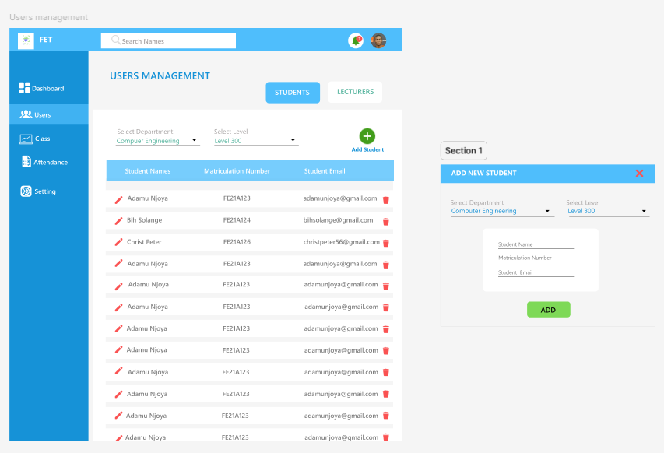

Slide 26
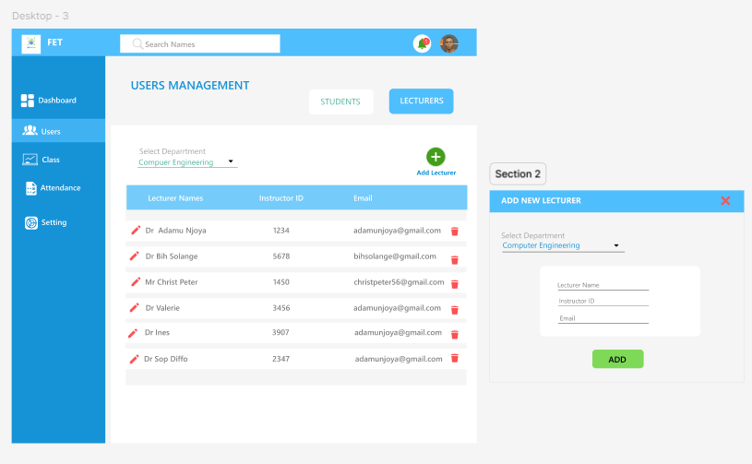

Slide 28
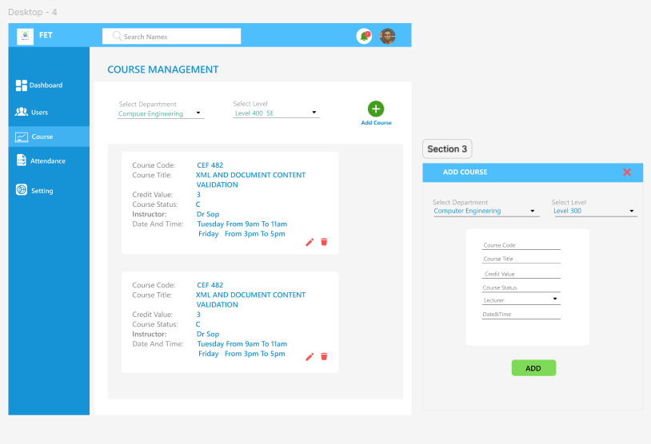

Slide 29
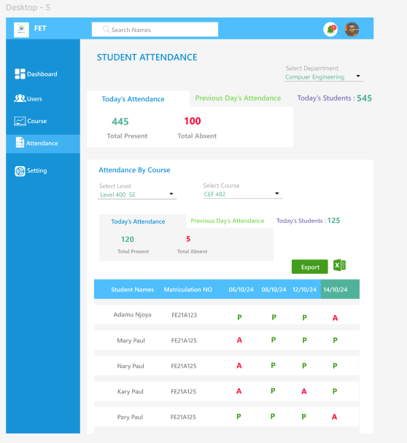

Slide 30
Conclusion
By adhering to design principles, incorporating user feedback and ensuring accessibility, we have developed and application that meets the needs of students, lecturers, and administrators

Slide 31

Thank you
Demo

Slide 32
